Slide 1
Risk Society: Toward a New Social Theory of Modernity
Unnatural Disasters
Seminar 12

Slide 2
Modern social politics
Defined in response to the problem of scarcity
Growth: increase production
Distribution of wealth:
Political struggles over failures to achieve fair distribution, or failure to achieve growth
Classical social theory of modernity: Marx vs. Durkheim vs. Weber
In no modern state is it legitimate for people to starve
Notes:
Marx = conflicts over scarce resources
Durkheim = the problem of social cohesion under industrial society
Weber = the process of modernization, new forms of subjectivity and personhood (e.g. Protestant ethic)

Slide 3
The role of science and technology
Science and technology allow mastery and control of nature to increase growth and productivity
Modernization = Humans vs. Nature
Post-Lisbon earthquake:
“We are not responsible for nature as such but for our practical and intellectual relation to it.”—Larsen, writing on Immanuel Kant

Slide 4
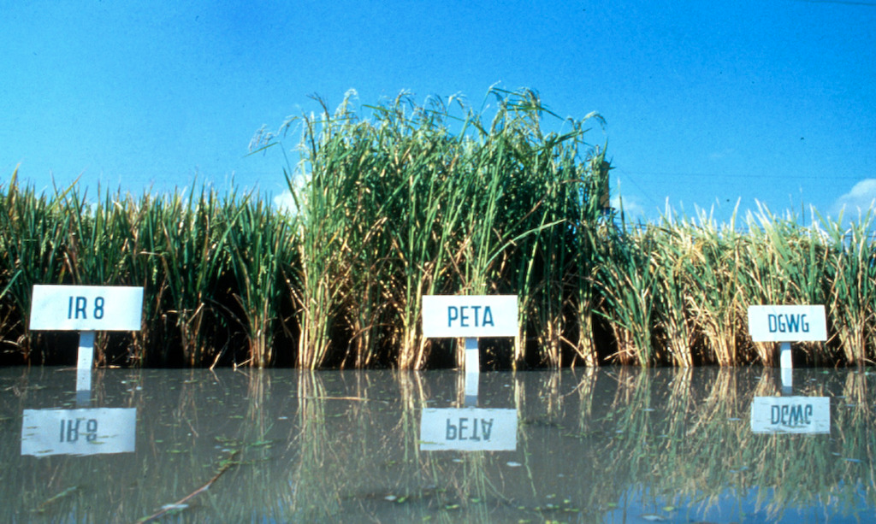
Example: The Green Revolution
Notes:
High yielding varieties of rice or wheat seeds developde in laboratory conditions, then extended out to poor farmers throughout the developing world (especially Mexico, India, Pakistan, Bangladesh, Phillipines, Indonesia. China had its own green revolution.

Slide 5
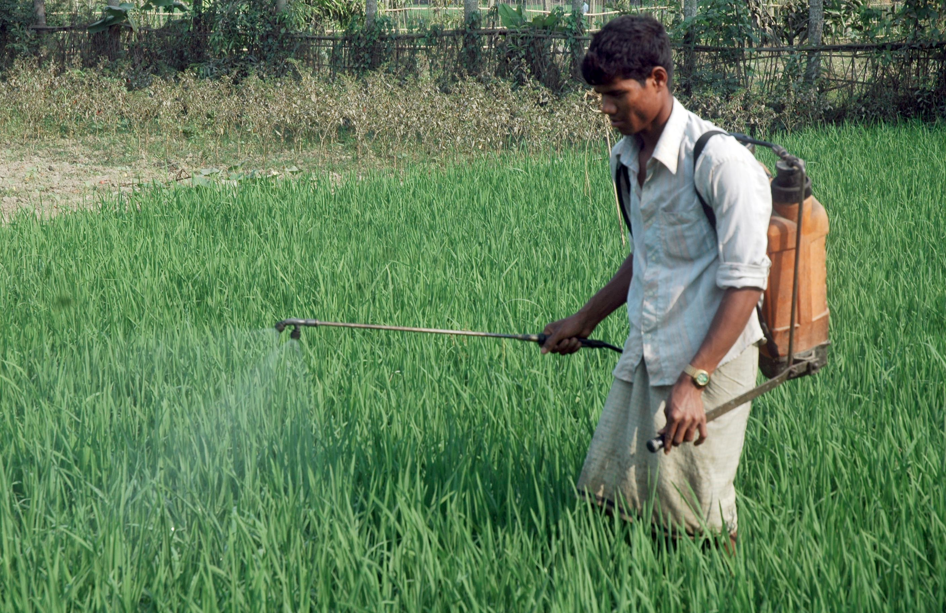
From natural to artificial environments

Slide 6
Rice and the environment: Green Revolution
SUNLIGHT
IRRIGATION
Herbicides and Pesticides
Water
Pests (insects)
Rice
Weeds
Industrial
Fertilizers
Soil:
Nitrogen
Phosphate
Potassium
Notes:
Huge increases in yield.

Slide 7
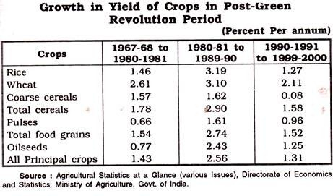
The green revolution worked

Slide 8
But . . .
“In advanced modernity the social production of wealth is systematically accompanied by the social production of risks. Accordingly, the problems and conflicts related to distribution in a society of scarcity overlap with the problems and conflicts that arise from the production, definition and distribution of techno-scientifically produced risks.”
-Ulrich Beck, Risk Society: 19.

Slide 9
The social production of risks
Each group identify one characteristic of the new “risks”. What distinguishes it from older problems of “scarcity” or poverty?

Slide 10
Green Revolution: Environmental Externalities
Resource Depletion
SUNLIGHT
IRRIGATION
Herbicides and Pesticides
Water
Pests (insects)
Rice
Weeds
Soil:
Nitrogen
Phosphate
Pottassium
Industrial
Fertilizers
Runoff:
Pollution

Slide 11
Point 1: Risks are consequences of modernization
“In the past, the hazards could be traced back to an undersupply of hygienic technology. Today they have their basis in industrial overproduction. . . . They are risks of modernization. They are a wholesale product of industrialization, and are systematically intensified as it becomes global.”

Slide 12
Taking one “risk of modernization” as an example, how is this risk distributed in society?

Slide 13
Point 2: “Poverty is hierarchic, smog is democratic” (36)
Globalization of risks
Smog doesn’t stop at political boundaries
When food is contaminated with pesticides, everyone eats it
“a policy of making the Earth uninhabitable” (38)

Slide 14
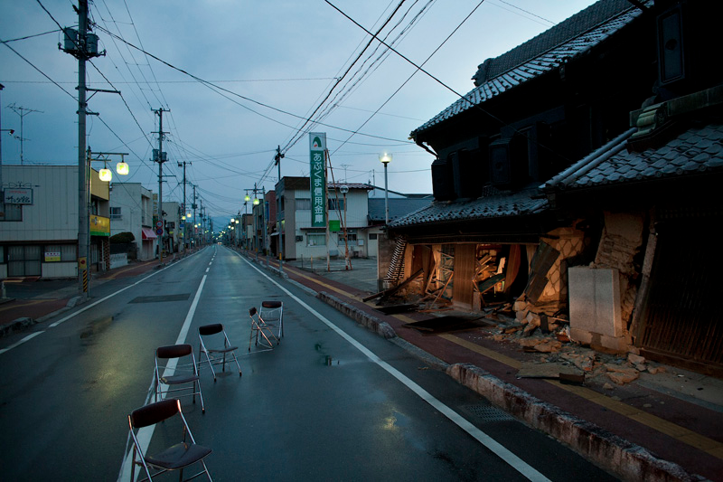
Fukushima Exclusion Zone

Slide 15
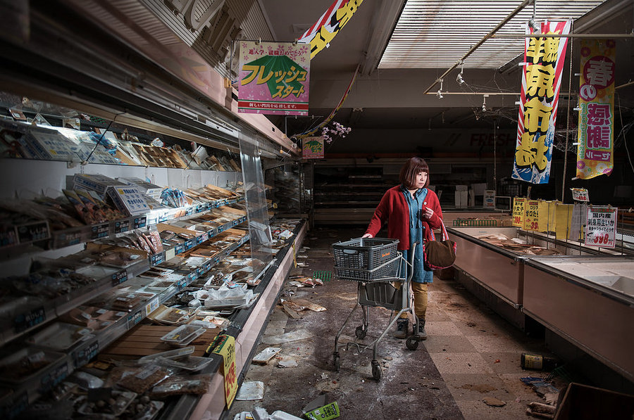
The new ‘blank spots’

Slide 16
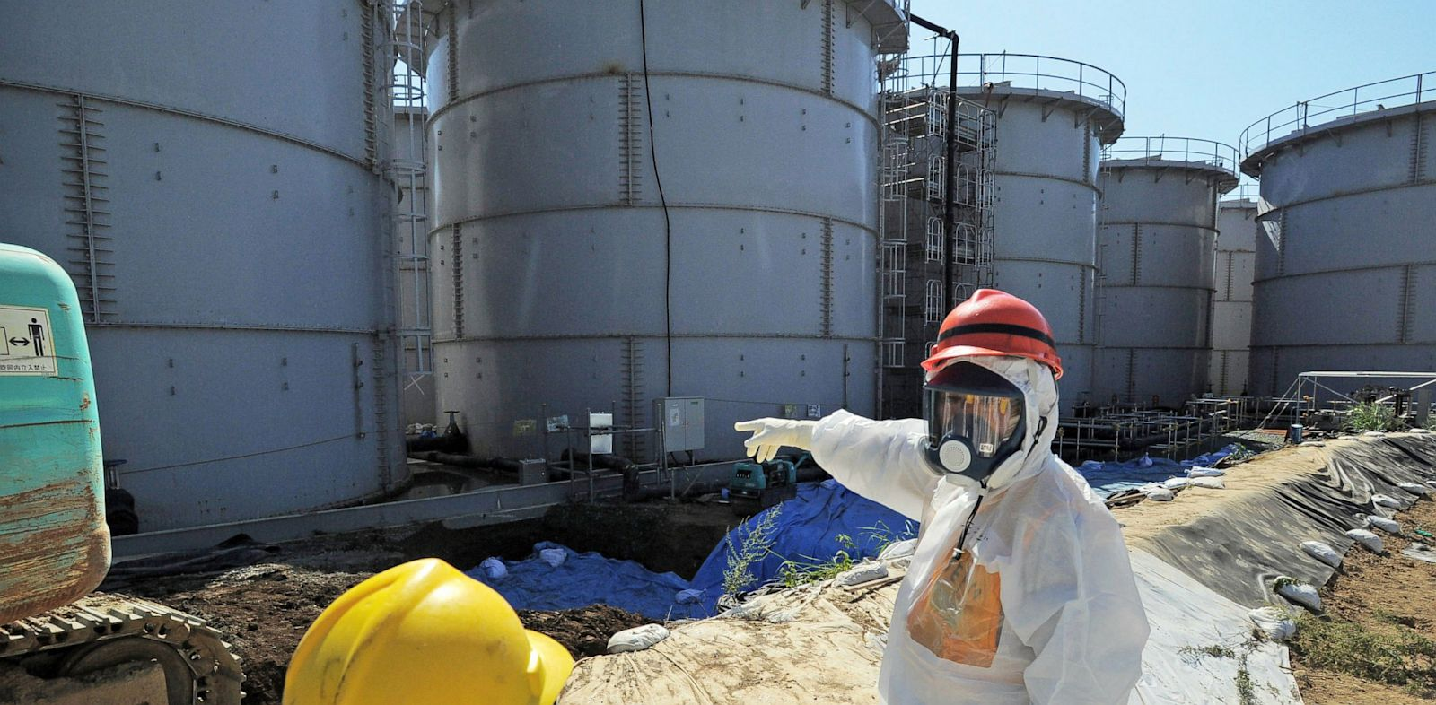
Monuments of what threatens us

Slide 17
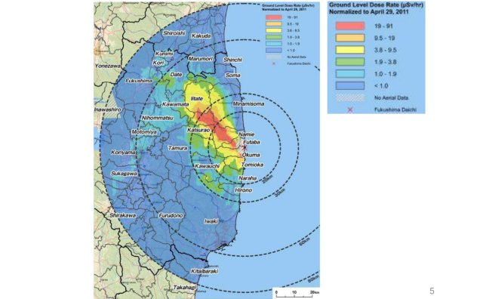
Notes:
Discuss the point made by Russel that it would have been better not to have evacuated. This doesn’t account for the politics and condition of risk.

Slide 18
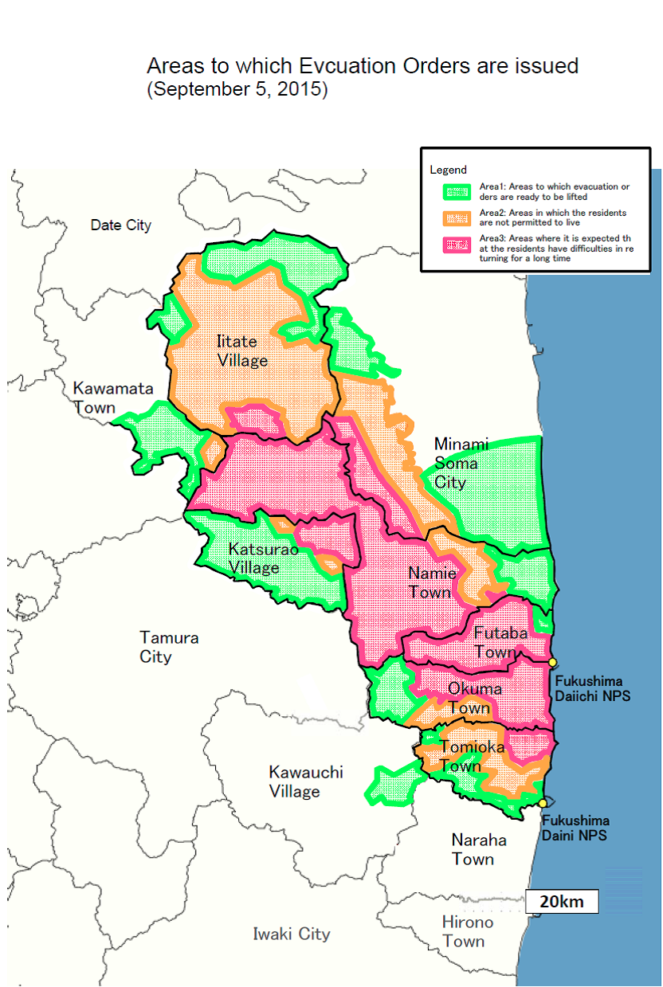

Slide 19
Boomerang effect
“Sooner or later the risks also catch up with those who produce or profit from them.”
Compare with Karl Marx’s theory of capitalism and inequality of wealth

Slide 20
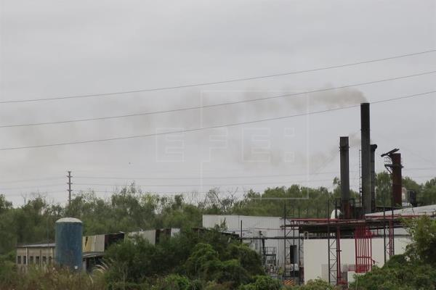
BUT ALSO: New international inequalities
Villa Inflamable, Dock Sud, Buenos Aires

Slide 21
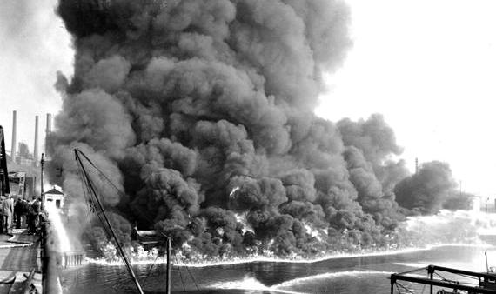
Bhopal, India, 1984

Slide 22
Discussion: Do you think risks are “democratic”? Are they distributed equally?

Slide 23
Point 3: Risk perception and definition
“conflictual pluralization and multiplicity of definitions of civilization’s risks”
Which risks are real? Which are important?

Slide 24
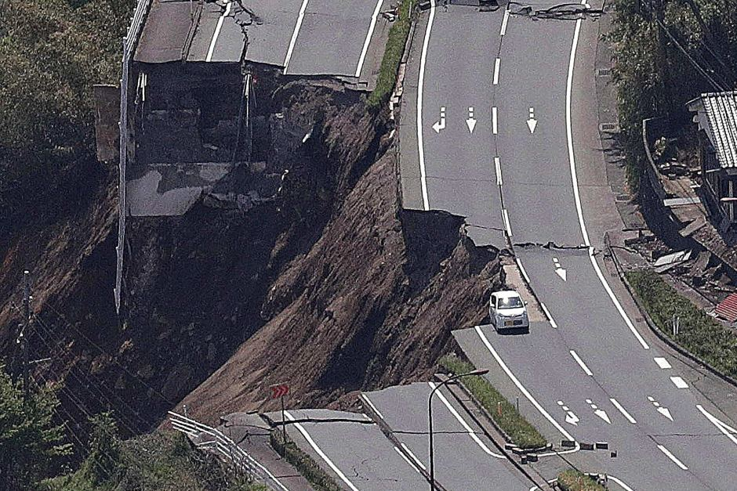
Old Risks

Slide 25
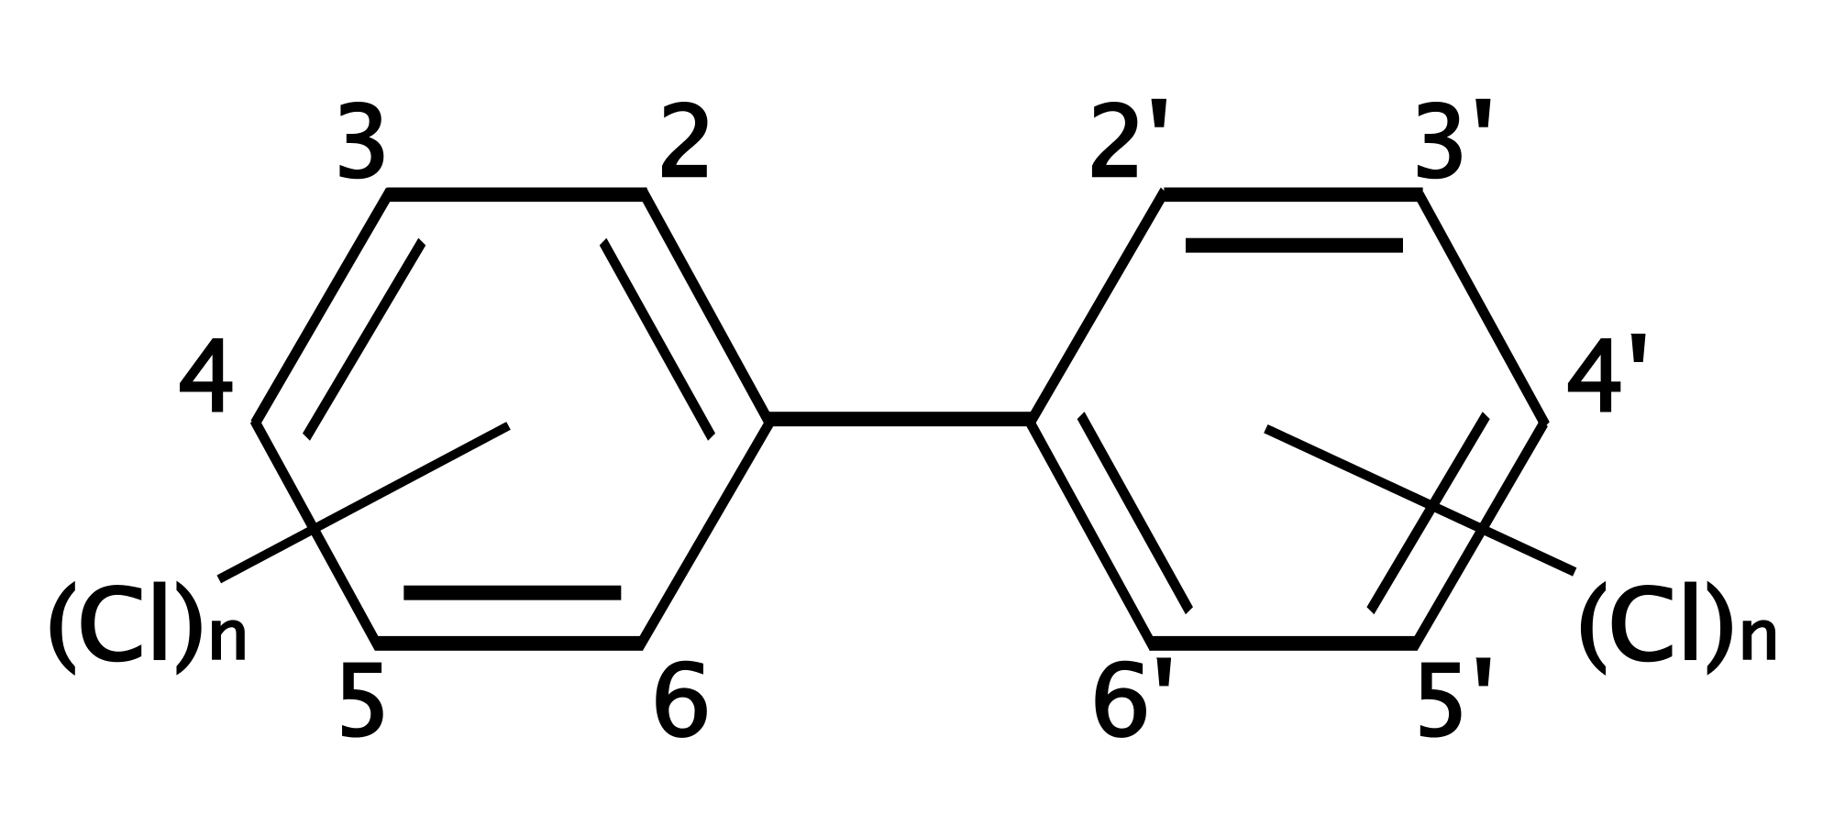
New risks

Slide 26
Debate.
In modernization, science and technology are tools to increase growth and production, improve life and society.
What do you think is the role of science and technology in ‘risk society’?

Slide 27
B. Modernization risks are “knowledge dependent” (26)
Modernization risks “require the ‘sensory organs’ of science—theories, experiments, measuring instruments—in order to become visible or interpretable as hazards at all.” (27)

Slide 28
C. “In definition of risks the sciences’ monopoly on rationality is broken.” “There is no expert on risk.” (29)
Acceptable vs. not acceptable risk
How do we wish to live? What is humankind? What do we think about nature?
Uncertainty is real (scientists cannot be certain)

Slide 29
D. “the not-yet-event as stimulus to action”
Risks are in the future

Slide 30
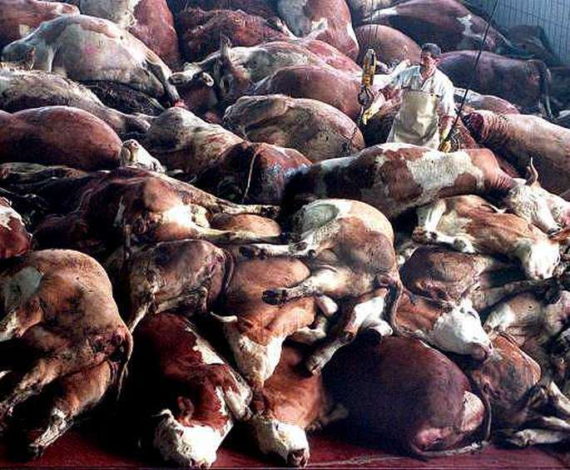
Example: Mad Cow Disease
Notes:
Pandemic flu.

Slide 31
The new politics of risk

Slide 32
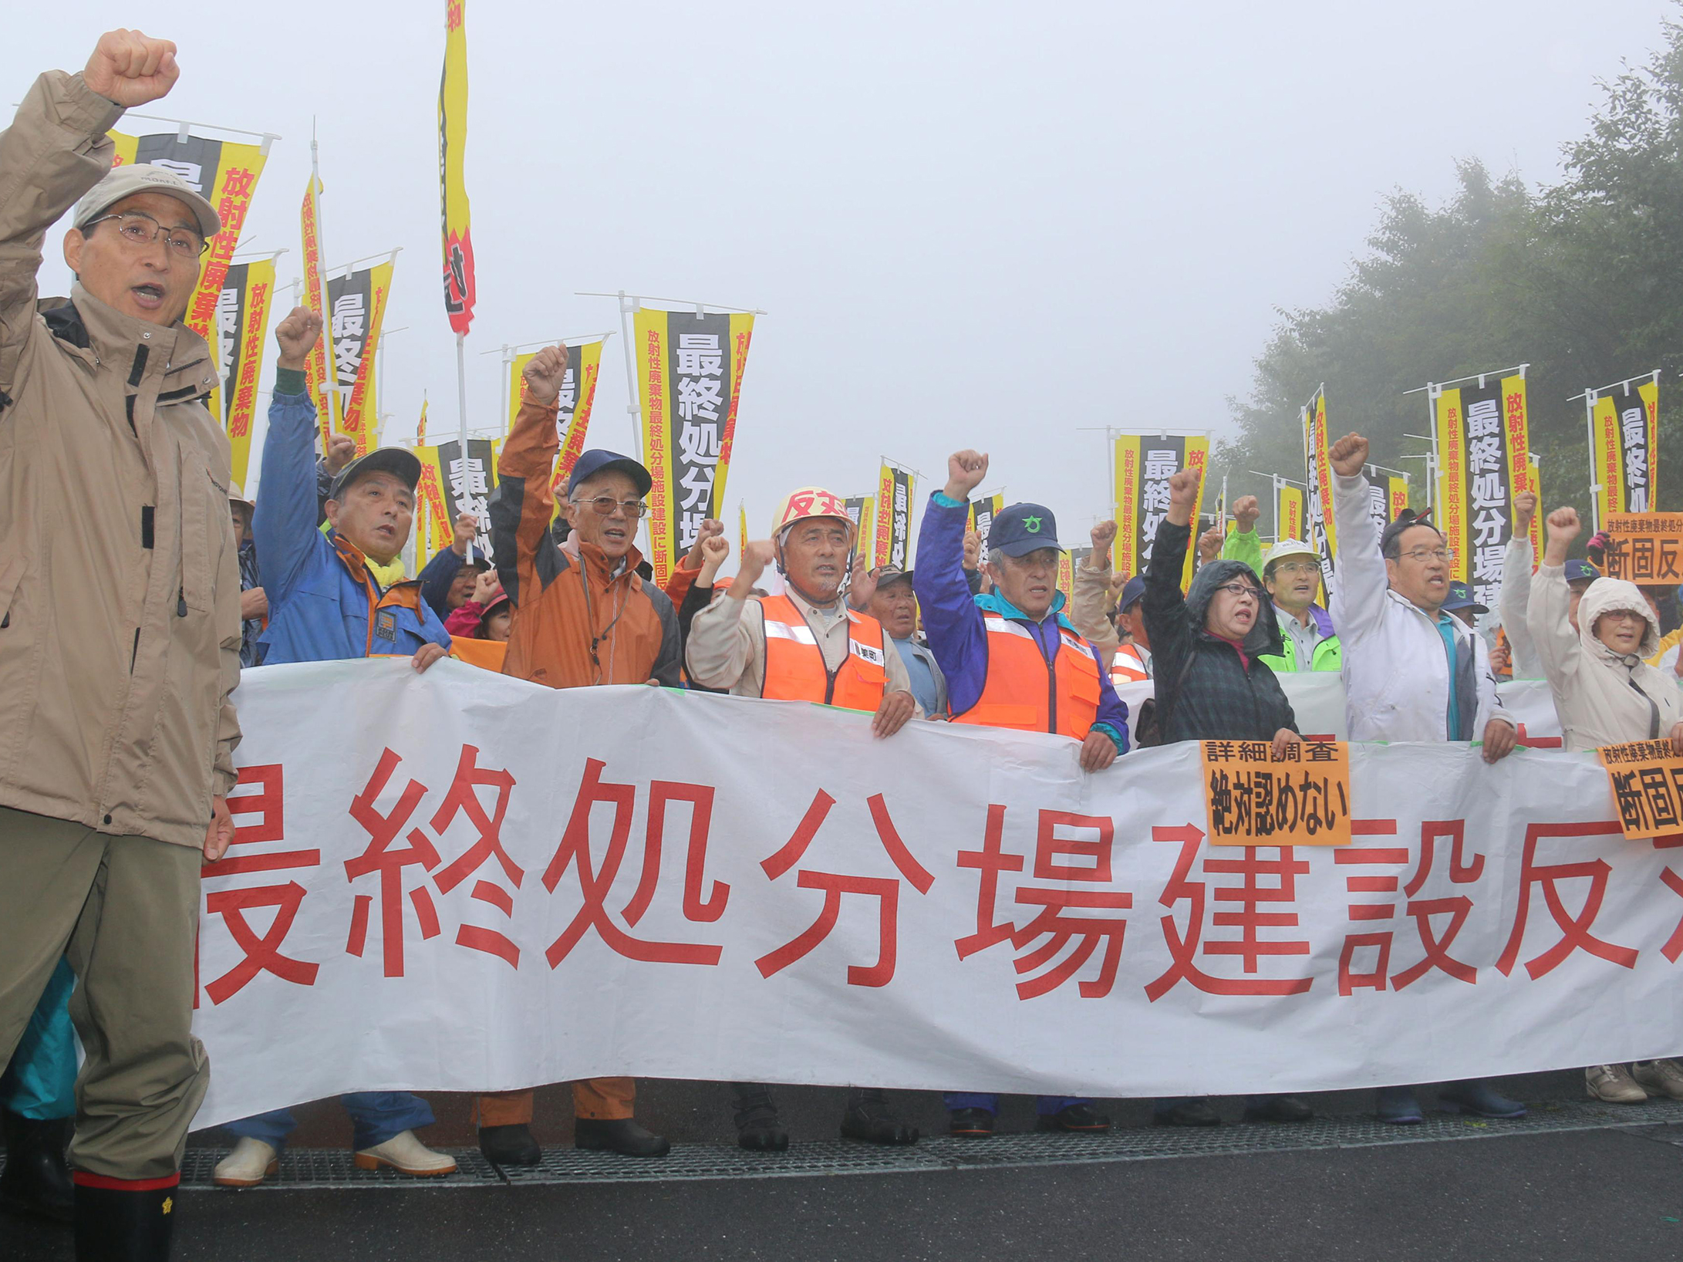
Miyagi residents physically block officials from surveying proposed nuke waste dump sites
The Japan Times, Sep 1 2015

Slide 33
Industrial Society
Risk Society
Proletariat, exploited working-class
Solidarity of need
Modernization
“Community of danger”
Solidarity of anxiety
Reflexive modernization

Slide 34
Risk and blame
"Risk is always related to security and safety. It is also always connected to responsibility." (Giddens, 7).

Slide 35
Risk and responsibility
Always disputable who is responsible
Organized irresponsibility: the “system”
"the systemic interdependence of the highly specialized agents of modernization in business, agriculture, the law and politics corresponds to the absence of isolable single causes and responsibilities."

Slide 36
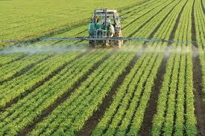
Pesticides
Who is at fault?

Slide 37
